Slide 1
2장. Divide-and-Conquer (분할/정복)
2-1. Binary Search (이분 검색)
2-3. The Divide-and-Conquer Approach
2-4. Quick Sort (Partition Exchange Sort)

Slide 2
▣ Divide-and-Conquer (분할/정복)
● The divide-and-conquer is a top-down approach.
● That is, the solution to a top-level instance of a problem is obtained
by going down and obtaining solutions to smaller instances.
● We now introduce the divide-and-conquer approach with examples,
starting with Binary Search.

Slide 3
2.1 Binary Search
● We showed an iterative version of Binary Search (Algorithm 1.5) in
Section 1.2.
● Here we present a recursive version because recursion illustrates the
top-down approach used by divide-and-conquer.

Slide 4
● The steps of Binary Search can be summarized as follows.
1. Divide the array into two subarrays about half as large.
If x is smaller than the middle item, choose the left subarray.
If x is larger than the middle item, choose the right subarray.
2. Conquer (solve) the subarray by determining whether x is in that
subarray. Unless the subarray is sufficiently small, use recursion to do this.
3. Obtain the solution to the array from the solution to the subarray.

Slide 5
▣ [Algorithm 1.5] : Binary Search (Iterative)
Problem: Determine whether x is in the sorted array S of size n.
Input: Positive integer n, sorted (nondecreasing order) array of keys S indexed from 1 to n, a key x.
Output: location, the location of x in S (0 if x is not in S).
void binsearch (int n, const keytype S[ ], keytype x, , index& location) { index low, high, mid; low = 1; high = n; location = 0; while (low <= high && location == 0) { mid = ┗^{(low + high) / 2}┙; if (x == S[mid]) location = mid; else if (x < S[mid]) high = mid - 1; else low = mid + 1; } }

Slide 6
▣ [Algorithm 2.1] : Binary Search (Recursive)
Problem: Determine whether x is in the sorted array S of size n.
Input: Positive integer n, sorted (nondecreasing order) array of keys S indexed from 1 to n, a key x.
Output: location, the location of x in S (0 if x is not in S).
index location (index low, , index high) { index mid; if (low > high) return 0; else { mid = ┗^{(low + high) / 2}┙; if (x == S[mid]) return mid; else if (x < S[mid]) return location(low, mid-1); else return location(mid+1, high); } }
S = [10, 12, 13, 14, 18, 20, 25, 27, 30, 35, 40, 45, 47]
x = 18

Slide 7
▣ [문제] : 다음과 같은 조건일 때, Binary Search 알고리즘을 이용하여
프로그램을 작성하시오.
S = [10, 12, 13, 14, 18, 20, 25, 27, 30, 35, 40, 45, 47]
x = 18

Slide 8
2.3 The Divide-and-Conquer Approach
Having two divide-and-conquer in detail, you should now better understand the following general description of this approach.
The divide-and-conquer design strategy involves the following steps:
1. Divide an instance of a problem into one or more smaller instances.
2. Conquer (solve) each of the smaller instances. Unless a smaller instance is sufficiently
small, use recursion to do this.
3. If necessary, combine the solutions to the smaller instances to obtain the solution to
the original instance.

Slide 9
2.4 Quick Sort (Partition Exchange Sort)
Next we look at a sorting algorithm, called “Quicksort,” that was developed by Hoare (1962).
● Array recursively divided into two partitions and recursively sorted
● Division based on a pivot
● pivot divides the two sub-arrays
● All items < pivot placed in sub-array before pivot
● All items >= pivot placed in sub-array after pivot

Slide 10
▣ [Example 2.3] Suppose the array contains these numbers in sequence:
1. Partition the array so that all items smaller than the pivot item are to the left of it and
all items larger are to the right:
2. Sort the subarrays:

Slide 11
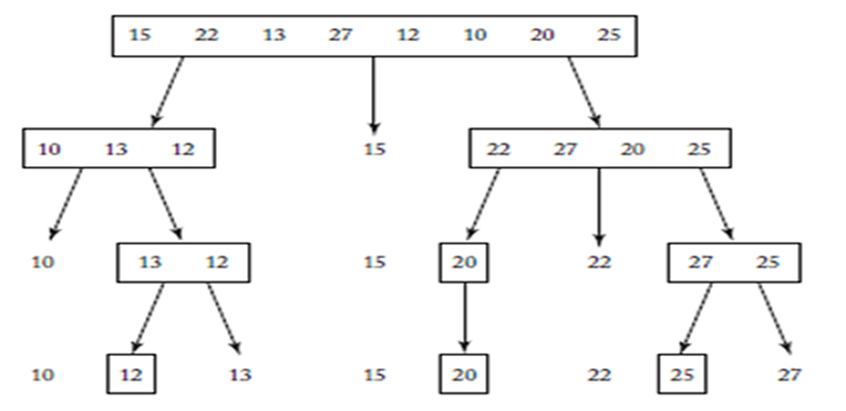
▣ [Figure 2.3] The steps done by a human when sorting with Quicksort.
The subarrays are enclosed in rectangles whereas the pivot
points are free.

Slide 12
▣ [Algorithm 2.6] : Quicksort
Problem: Sort n keys in nondecreasing order.
Inputs: Positive integer n, array of keys S indexed from 1 to n.
Outputs: the array S containing the keys in nondecreasing order.
void quicksort (index n, index high) { index pivotpoint; if (high > low) { partition (low, high, pivotpoint); quicksort (low, pivotpoint - 1); quicksort (pivotpoint + 1, high); } }

Slide 13
▣ [Algorithm 2.7] : Partition
Problem: Parttition the array S for Quicksort.
Inputs: two indices, low and high, and the subarray of S indexed from low to high.
Outputs: pivotpoint, the pivot point for the subarray indexed from low to high.
void partition (index low, index high, index& pivotpoint) { index i, j; keytype pivotitem; pivotitem = S[low]; j= low; // Choose first item for pivotitem. for (i = low+1; i <= high; i++) if (S[i] < pivotitem) { j++; exchange S[i] and S[j]; } pivotpoint = j; exchange S[low] and S[pivotpoint]; // Put pivotitem at pivotpoint. }

Slide 14
▣ [문제] : 다음과 같은 조건일 때, Partition 알고리즘을 이용하여
프로그램을 작성하시오.
S = [15, 22, 13, 27, 12, 10, 20, 25]

Slide 15
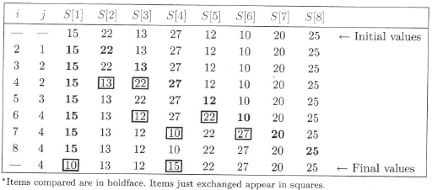
▣ [문제] : 다음과 같은 조건일 때, Partition 알고리즘을 이용하여
프로그램을 작성하시오.
S = [15, 22, 13, 27, 12, 10, 20, 25]
● Table 2.2 An example of procedure partition

Slide 16
● Procedure partition works by checking each item in the array in sequence.
● Whenever an item is found to be less than the pivot item,
it is moved to the left side of the array.
● Table 2.2 shows how partition would proceed on the array in Example 2.3.

Slide 17
▣ [문제] : 다음과 같은 조건일 때, Quick Sort 알고리즘을 이용하여
프로그램을 작성하시오.
S = [15, 22, 13, 27, 12, 10, 20, 25]

